Slide 1
Real-Time Scheduling Simulator
Server-Based Algorithms for Mixed Periodic-Aperiodic Workloads
Shahab Afshar
CPR E 458/558: Real-Time Systems, Fall 2024
Department of Electrical and Computer Engineering
Iowa State University

Slide 2
Problem Statement: The Challenge
Real-time systems must satisfy timing constraints in addition to functional correctness
Real-World Example: Automotive ECU
Periodic tasks: Engine control (10ms), ABS monitoring (5ms), fuel injection (20ms)
Aperiodic tasks: Driver button presses, diagnostic requests, error handling
The Gap
Theoretical analysis provides utilization bounds but doesn't show temporal behavior
Manual schedule construction is tedious and error-prone
RTOS testing requires significant development effort
Engineers need to explore algorithm behavior before committing

Slide 3
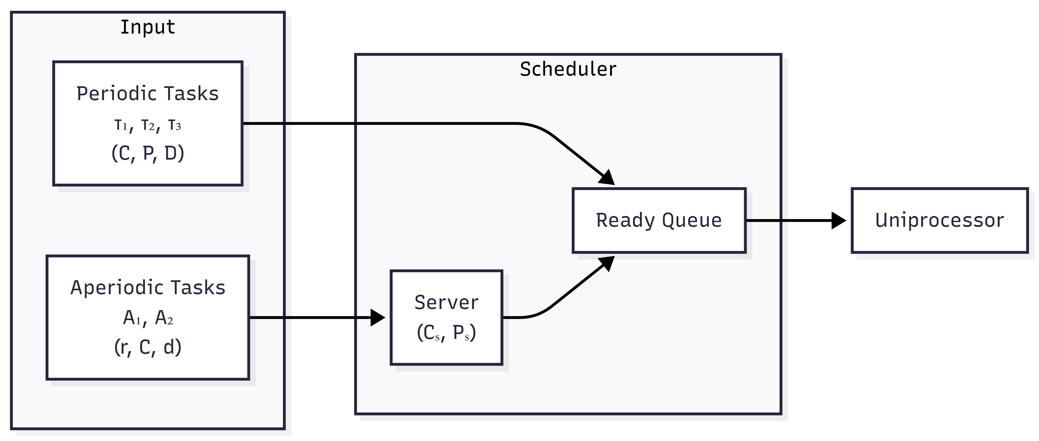
Research Questions
RQ1: Can a discrete-event simulator faithfully implement server capacity management policies?
RQ2: Does interactive visualization help users understand algorithm differences?
RQ3: Can parameter exploration (varying Cs/Ps) reveal optimal configurations?

Slide 4
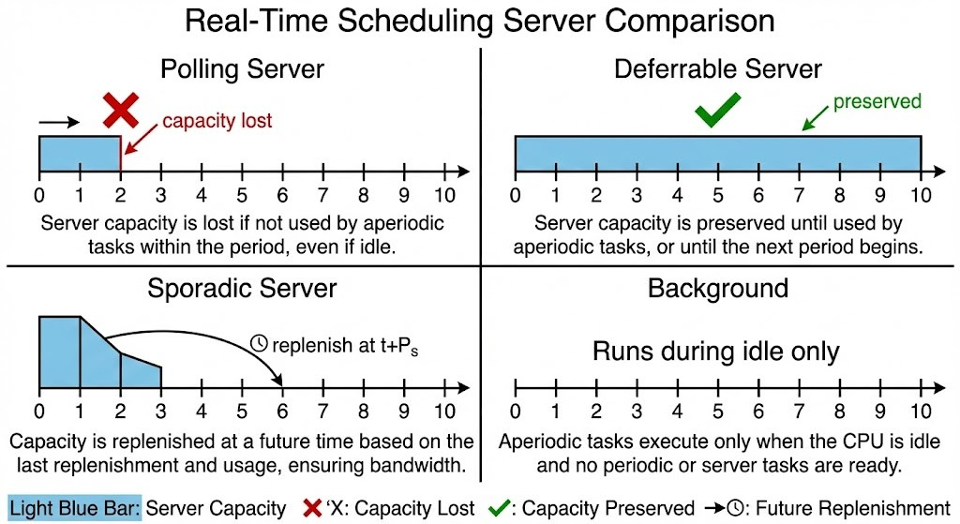
Solution: Four Server-Based Scheduling Algorithms
Polling Server
• Capacity lost if no aperiodic tasks → Moderate response
Deferrable Server
• Capacity preserved until period end → Good response
Sporadic Server
• Dynamic replenishment at t+Ps → Best response
Background Scheduler
• Runs during CPU idle only → Worst response
Sources: Sprunt et al. (1989), Lehoczky et al. (1987)

Slide 5
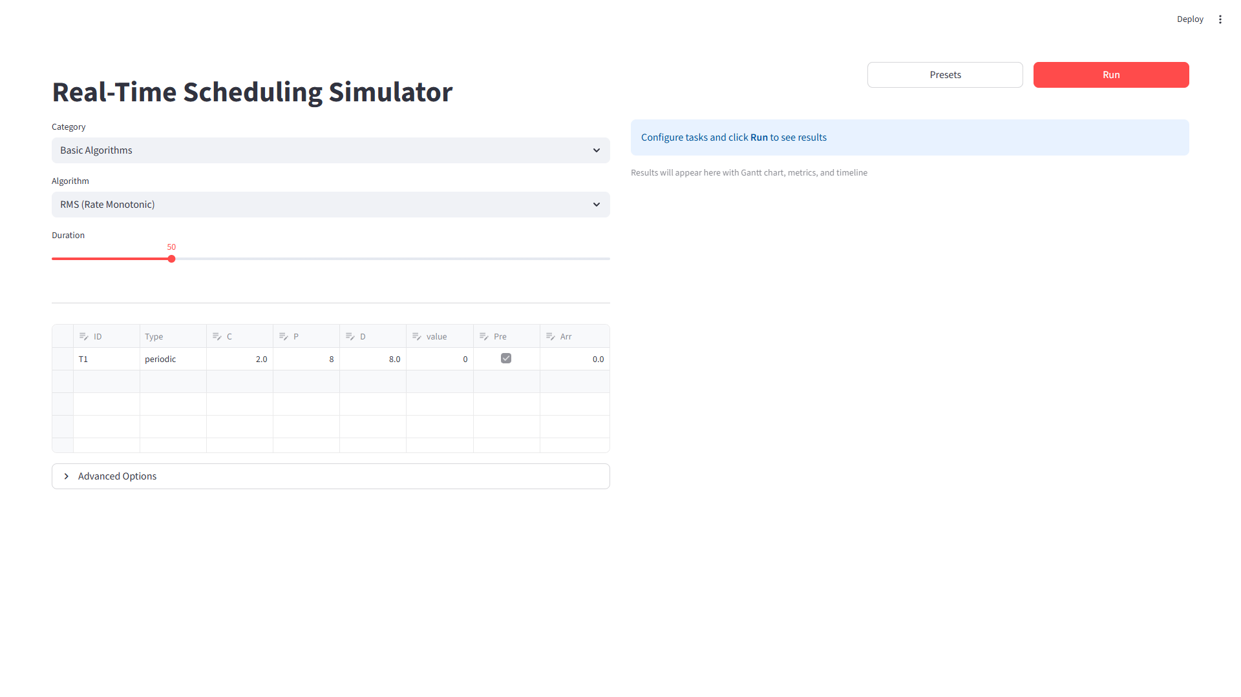
Interactive Simulation Platform
Core Features
Discrete-event simulation with exact algorithm implementation
Interactive Gantt charts showing capacity events
Parameter exploration via sliders (Cs, Ps)
21 preset configurations for quick experimentation
Schedulability analysis (RMS, EDF, DMS bounds)
Supported Algorithms
Basic: RMS, EDF, DMS, LLF — Liu & Layland (1973)
Server-Based: Polling, Deferrable, Sporadic, Background
Advanced: Precedence-constrained, Overload handling, Value-based (HVDF)

Slide 6
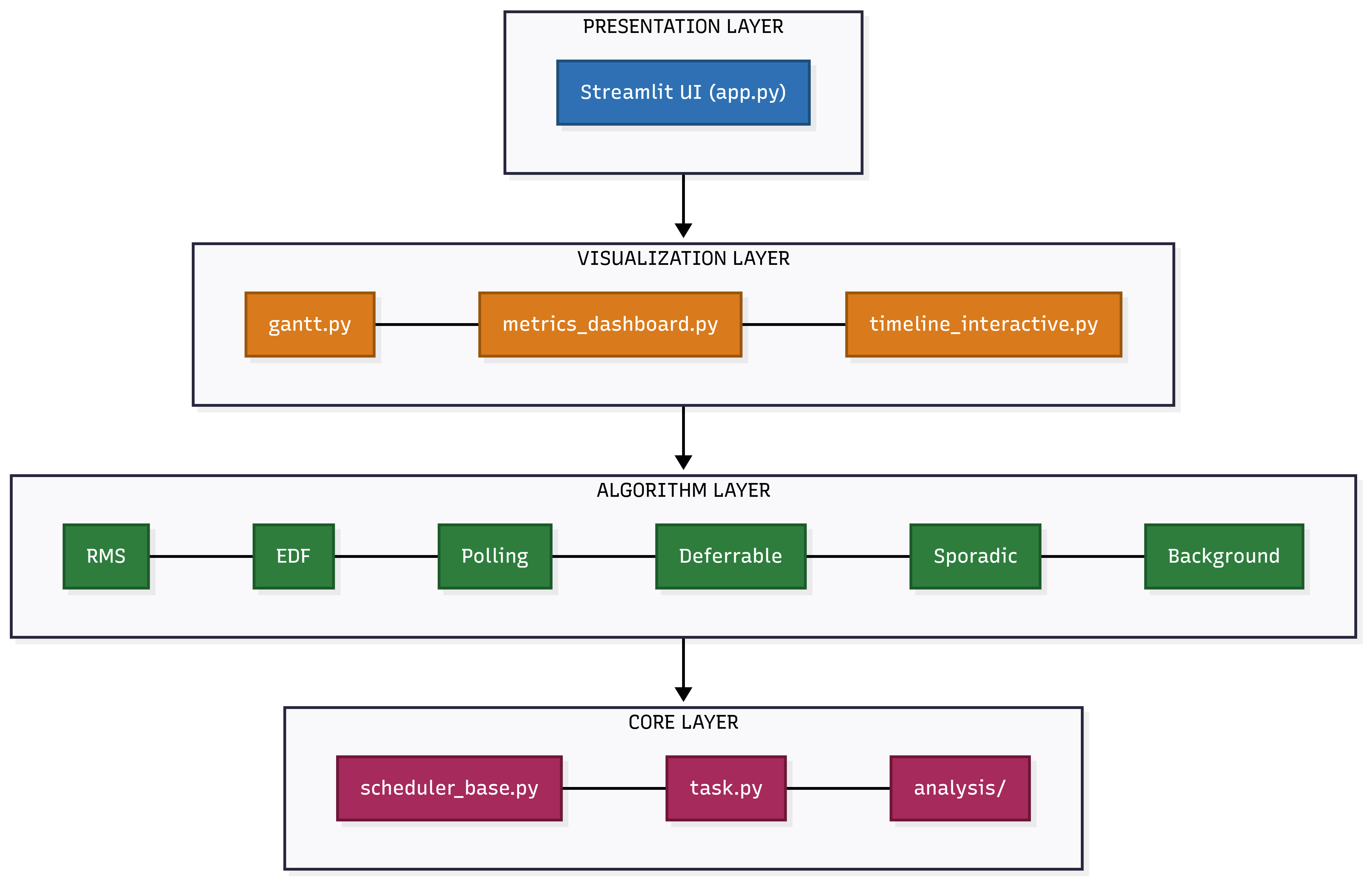
Software Architecture
Layered Design with Clear Separation of Concerns
Technology Stack
Core Logic: Python 3.10+ — Simulation engine
Web UI: Streamlit — Interactive dashboard
Visualization: Plotly — Gantt charts, metrics
Data Handling: Pandas — Task tables, export

Slide 7
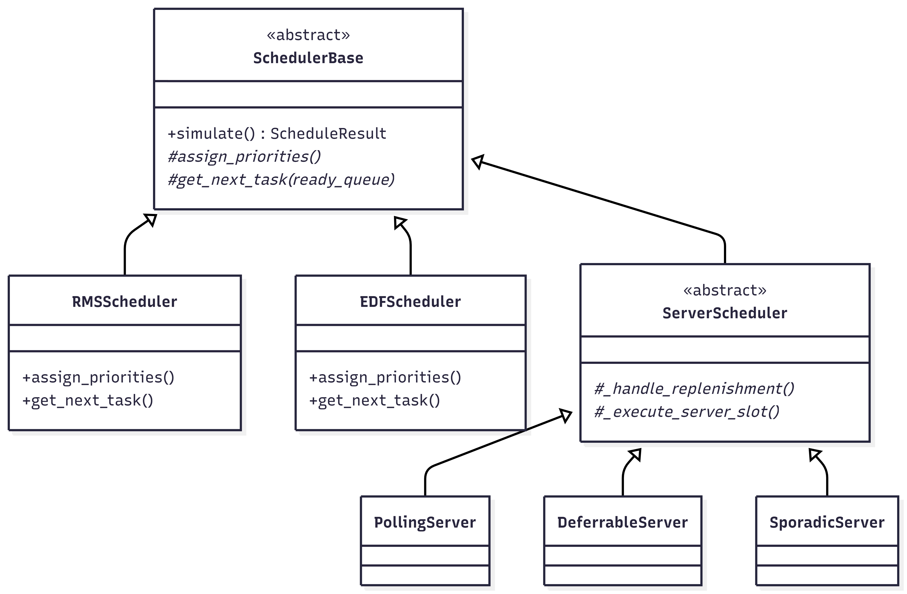
Design Pattern: Template Method
Key Insight: All schedulers share the same simulation loop; only priority assignment differs.
Capacity Management Difference
Polling: self.server_remaining = 0 (capacity lost)
Deferrable: return False (capacity preserved)
Sporadic: Schedule replenishment at t + Ps

Slide 8
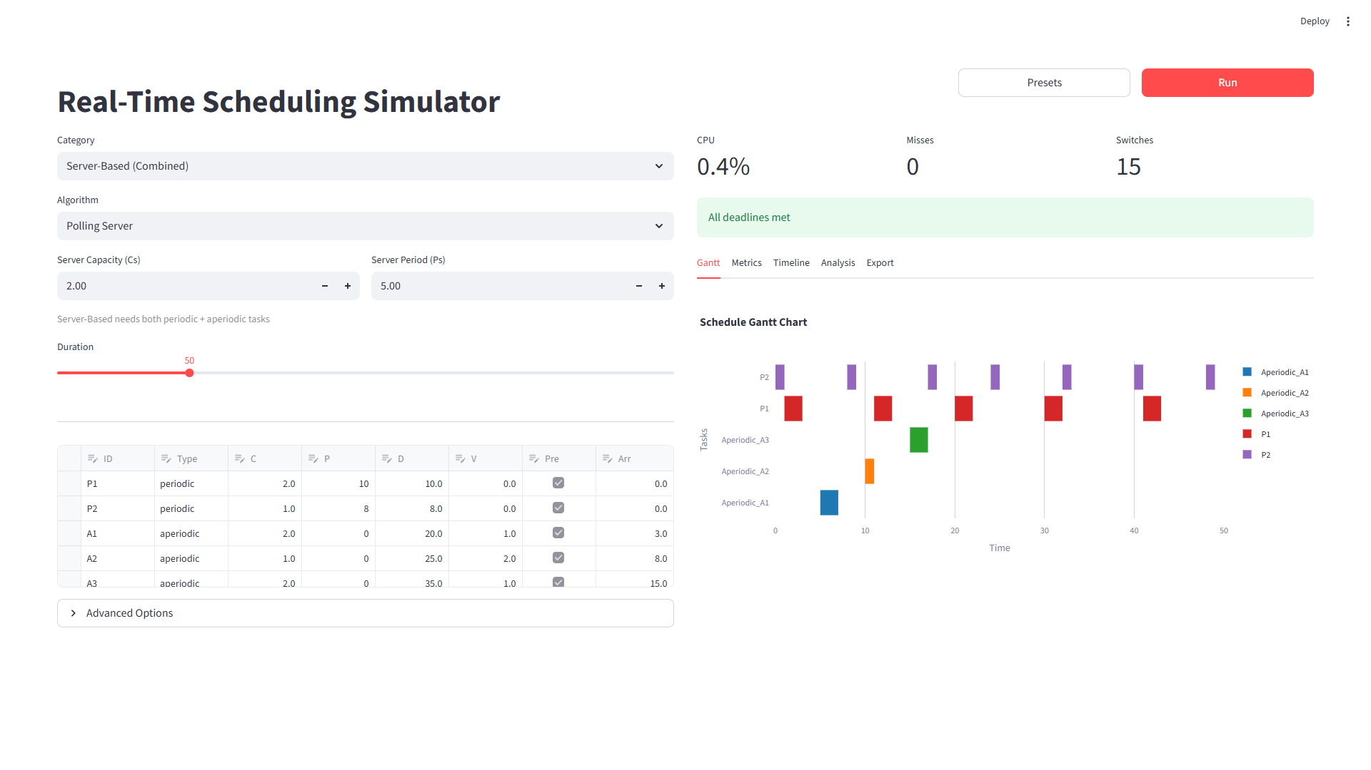
Correctness Validation (RQ1)
Server Behavior Verification
Polling: capacity_lost events when idle ✓
Deferrable: deferred events preserve capacity ✓
Sporadic: replenish events at t + Ps ✓
Background: Runs only during CPU idle ✓
Gantt Chart Evidence

Slide 9
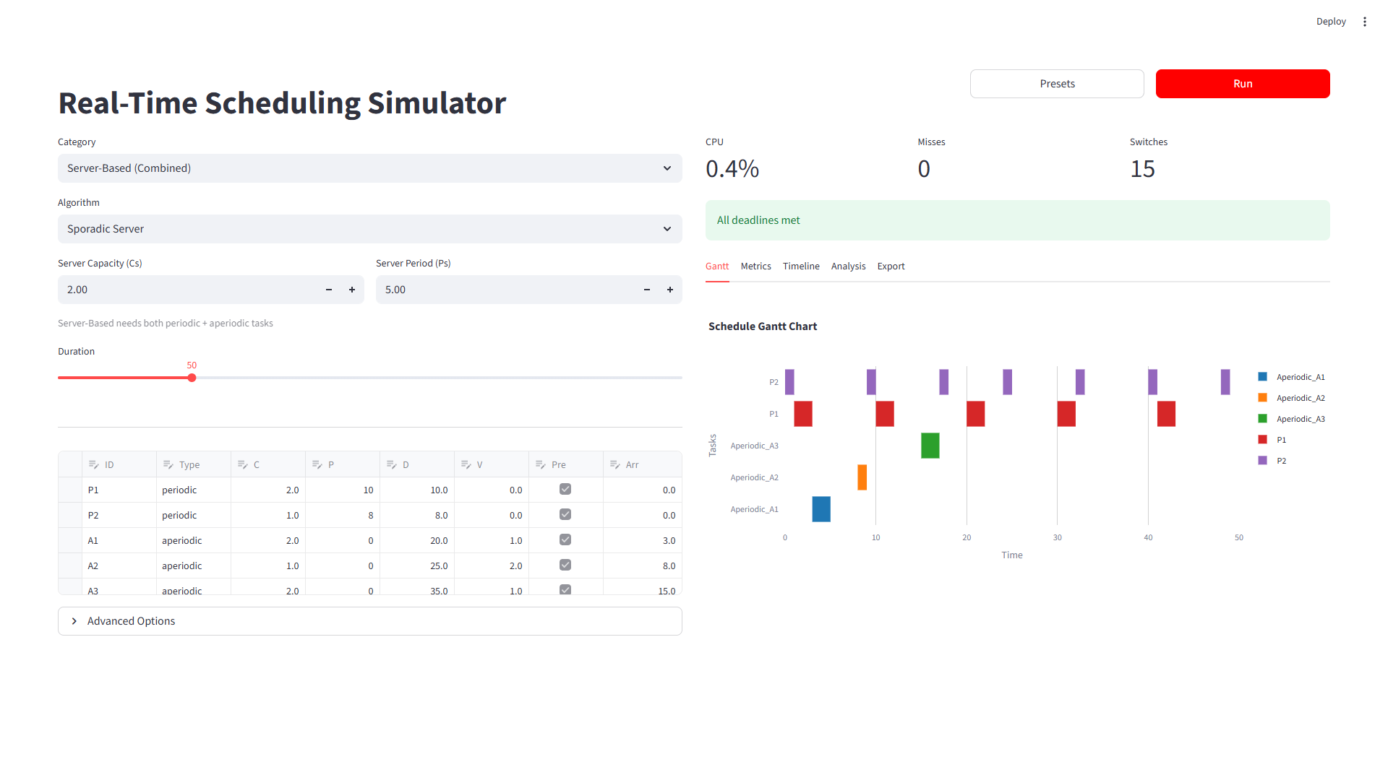
Parameter Sensitivity & Visualization (RQ2, RQ3)
Server Capacity Effect on Response Time
Workload: P1(C=1,P=10), P2(C=1,P=15), A1(C=8, arrives t=0)
Cs=2, Ps=5 → Response Time: 17, Replenishments: 4
Cs=4, Ps=5 → Response Time: 9, Replenishments: 2
Cs=8, Ps=5 → Response Time: 8, Replenishments: 1
Finding: Larger Cs reduces aperiodic response time by reducing replenishment cycles
Visualization Features (RQ2)
Color-coded task bars (periodic vs. aperiodic)
Red triangles mark deadlines
Server events labeled on timeline
Hover tooltips show remaining computation

Slide 10
Conclusions
Research Question Answers
RQ1: Faithful Implementation ✓ — Verified by observing expected capacity events
RQ2: Visualization Effectiveness ✓ — Gantt charts clearly show algorithm differences
RQ3: Parameter Exploration ✓ — Varying Cs from 2→8 shows response time reduction (17→8)
Key Contributions
1. Open-source simulator with 4 server algorithms
2. Interactive Gantt charts displaying capacity events
3. 21 preset configurations from literature examples
4. Parameter exploration via sliders
5. Schedulability analysis (RMS, EDF, DMS)

Slide 11
Limitations & Future Work
Current Limitations
Single-processor only: Multi-core scheduling not yet supported
No resource contention: PIP/PCP protocols implemented but not integrated
Limited validation: User study needed for formal RQ2 assessment
Simulation scope: Does not model I/O delays, cache effects
Future Directions
Multi-core extension: Partitioned and global scheduling algorithms
Resource protocol integration: PIP/PCP for shared resource scenarios
RTOS trace import: Compare simulation with FreeRTOS/Zephyr traces
Formal verification: Model checking for schedulability guarantees

Slide 12
Learning Achieved
Technical Skills Developed
Real-Time Systems: Server-based scheduling, RMS bounds, capacity management
Software Engineering: Template Method pattern, Strategy pattern, event-driven design
Tools: Python simulation, Streamlit UI, Plotly visualization
Lessons Learned
1. Simulation reveals behavior that formulas cannot show
2. Visualization is essential for understanding scheduling dynamics
3. Parameter exploration enables informed design decisions
4. Modular architecture simplifies adding new algorithms

Slide 13
References
[1] B. Sprunt, L. Sha, and J. Lehoczky, "Aperiodic task scheduling for hard-real-time systems," Real-Time Systems, vol. 1, no. 1, pp. 27-60, 1989.
[2] J. P. Lehoczky, L. Sha, and J. K. Strosnider, "Enhanced aperiodic responsiveness in hard real-time environments," IEEE RTSS, pp. 261-270, 1987.
[3] M. Spuri and G. Buttazzo, "Scheduling aperiodic tasks in dynamic priority systems," Real-Time Systems, vol. 10, no. 2, pp. 179-210, 1996.
[4] C. L. Liu and J. W. Layland, "Scheduling algorithms for multiprogramming in a hard-real-time environment," JACM, vol. 20, no. 1, pp. 46-61, 1973.

Slide 14
Thank You
Questions?
Shahab Afshar
Department of Electrical and Computer Engineering
Iowa State University

